Slide 1

The Machine Learning Process
Python 101 – Decorators
Sathish Ravichandran

Slide 2
Decorators
Imagine you created a function and later you want to add some new capabilities to the function:
def simple_func():
#Want to do more stuff!
# Do Simple stuff
return something

Slide 3

Decorators
Two basic ways are
Add the extra code (functionality) to your old function.
Create a brand new function that contains the old code, and then add new code to that function.
And if we want to remove the functionality we need to do it manually
This is where decorator is useful. It allows us to track on extra functionality to an already existing function.

Slide 4
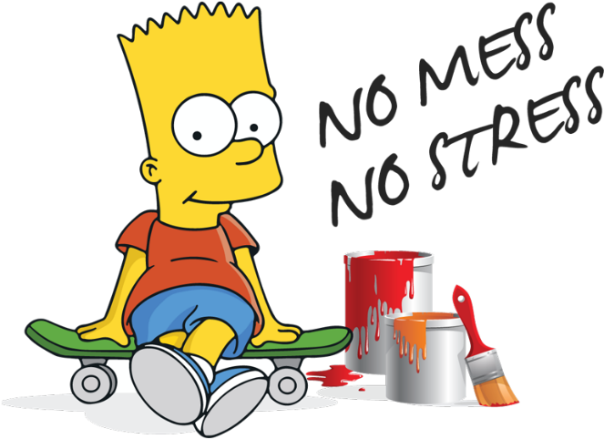
Decorators
Decorators use the @operator and are then placed on top
of the original function
@some_decorator
def simple_func():
#Do simple stuff
return something

Slide 5
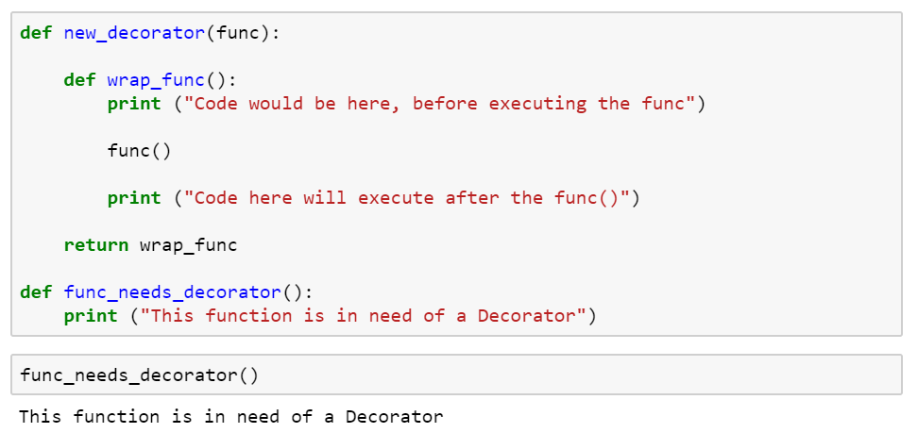
Example 01 – Creating a Decorator
New Functionality
Original Function
Notes:
def new_decorator(func):
def wrap_func():
print ("Code would be here, before executing the func")
func()
print ("Code here will execute after the func()")
return wrap_func
def func_needs_decorator():
print ("This function is in need of a Decorator")
func_needs_decorator()

Slide 6
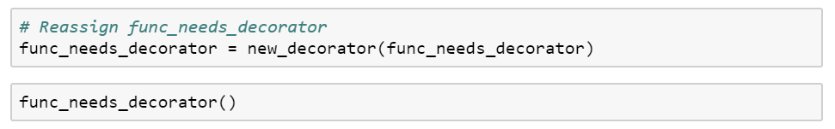

Example 01
What is the expected output here?
Notes:
func_needs_decorator = new_decorator(func_needs_decorator)
func_needs_decorator()

Slide 7
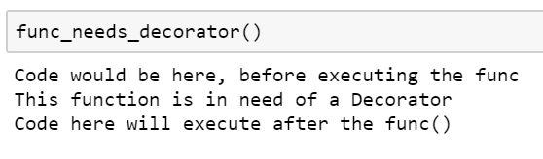

Example 01- result
A decorator wrapped the function and modified its behavior.
Notes:
func_needs_decorator()

Slide 8
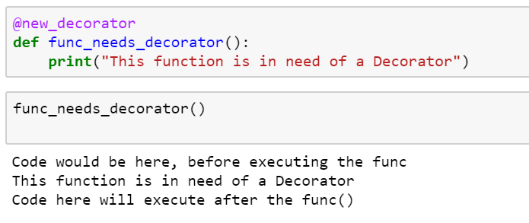
Python decorator@
Notes:
@new_decorator
def func_needs_decorator():
print("This function is in need of a Decorator")
func_needs_decorator()

Slide 9
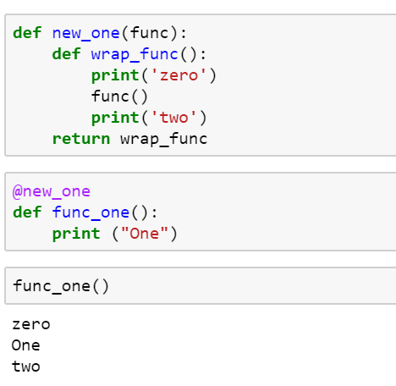
Example-02
New Functionality
Decorator
Original Function
Notes:
def new_one(func):
def wrap_func():
print('zero')
func()
print('two')
return wrap_func
@new_one
def func_one():
print ("One")
func_one()

Slide 10
Thank you
The Capacity to learn is a gift;
The ability to learn is a skill;
The willingness to learn is a choice.
-Brian Herbert

